Slide 1
Basic Details of the Team and Problem Statement
Problem Statement : To Create a Website for Educational Assistance and Development for Engineering Students
Domain : Software
Theme Name: Smart City Education

Slide 2
PROPOSED IDEA
PROPOSED SOLUTION
Pursuing Engineering involves more than just academics, including projects, paper publications, online courses etc.,
Finding the required materials and mentors can be difficult for students who are interested in learning and building things.
To address this issue, we have planned to create a website that helps Engineering Students enhance their knowledge and skills.
The website's distinctiveness lies in its dedication to constructing a robust framework with a primary focus on Engineering Students.
TECHNOLOGY STACK USED
Windows 11 SDK
Python programming language
Django
HTML
CSS
Django Rest Framework API

Slide 3
USES AND IMPACT
USE CASES
REGION OF IMPACT (The Target Audiences)
Speech Assistant for conversational Q&A, pronunciation assistance, and audio output.
Photo search for visualizing complex concepts with technical illustrations and diagrams.
Library database for research and finding relevant materials.
Doubt clarification with video and speech feedback for personalized guidance.
Forums for building a sense of community and getting answers from peers and experts.
Personal notes and personalized department notes/textbooks for reinforcement and time-saving learning.
Our target audience/region of impact is engineering students as this website aims to:
Provides useful tools and resources that cater to the specific learning needs of engineering students.
Help students enhance their learning experience and achieve their academic goals.
Support students' curiosity, passion for learning, and problem-solving skills.
Offer easy access to relevant and high-quality resources.
Help aspiring engineers become successful and accomplished in their field.
Foster a community of like-minded individuals focused on learning and collaboration.

Slide 4
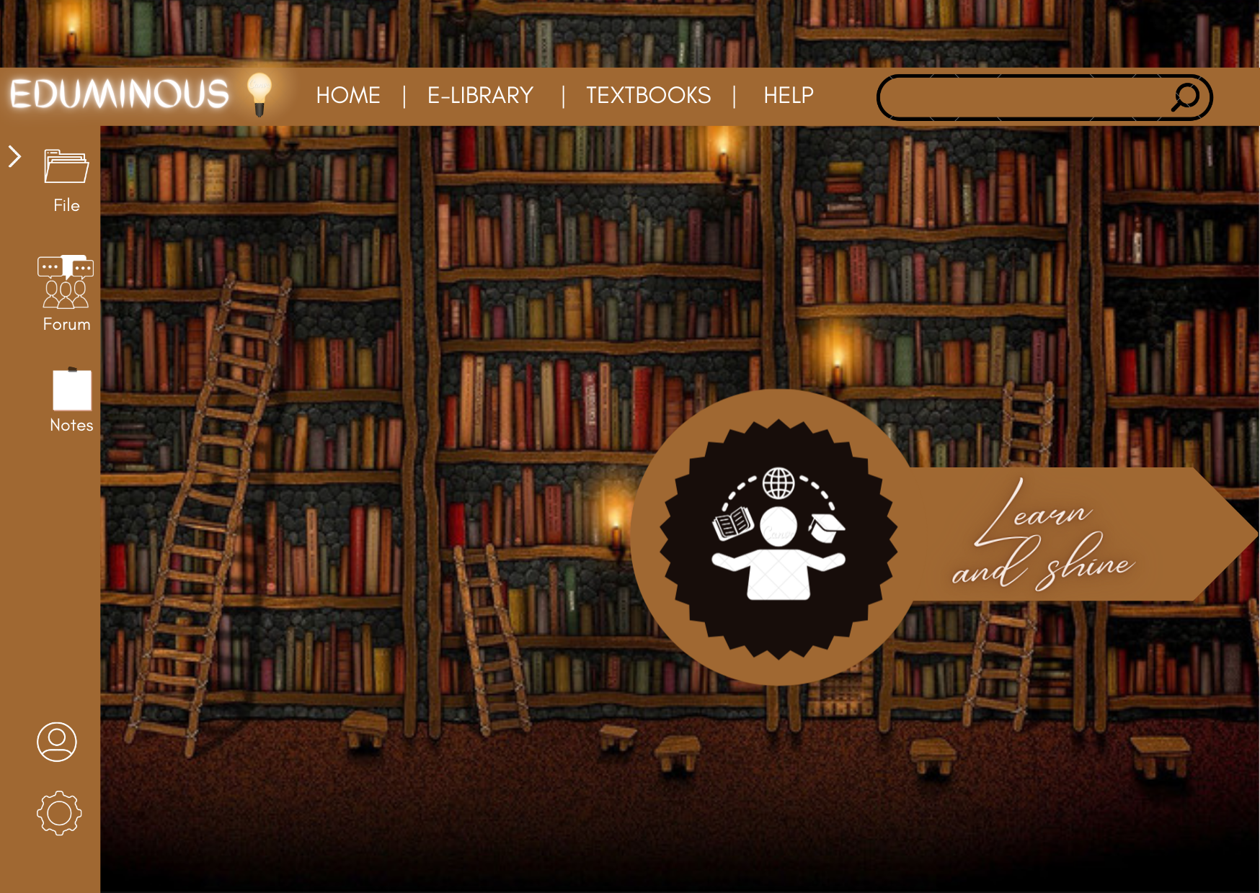
shreerecvidyam@4

Slide 5
USER INTERFACE OF WEBSITE
USER EXPERIENCE
DEPENDENCIES REQUIRED
Each aspect mentioned here add value for unanimous use of the website for Engineering Students to make the end user happy.
USEFUL: Doubt Clarification by Photo Search and Speech assistant voice note, E-Library, Forum for Open Doubts, personalised department notes and textbooks.
USAGE: Library Database gives clear insight of concept by the respective textbook, video suggestion and also can purchase books.
DESIRABLE: Easier to manage the studies within a website instead rather causing chaos.
ACCESSIBILITY:The website accounts for visual impairment or other disabilities by facilitating Speech Recognition throughout the website.
CREDIBLE:The site has secure access consisting of user id and unique password.
FINDABLE: Personalised notepad provided for marking important dates as well as doubts.
VALUABLE: The self-service features on the website improve Student Satisfaction making it a worthwhile experience for the students to rely upon for complete learning.
DEPENDENCIES:
Laptop with medium specification
Good WiFi connection
Server with Database
SHOW STOPPER:
Change of version in python
Change of version in django

Slide 6
RUN DOWN
The website is designed for engineering students to enhance their learning experience.
The website provides E-library and textbooks features with materials from trusted sources.
The website uses speech recognition for easy access to various features.
An open forum is provided to connect with like-minded people, find mentors, and clear doubts.
The overall aim is to provide assistance anytime, anywhere and to build a robust framework for learning.

